Slide 1
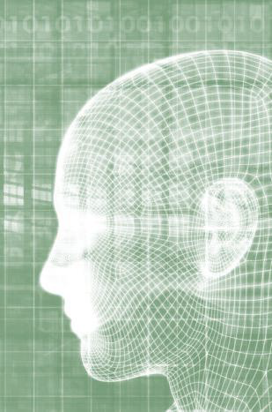


Eleven Supercase Data Challenge
Designing an Image Recognition system for gas tanks
To the attention of Eleven Strategy and Total direct energie
20/09/2019

Slide 2
AGENDA
Presentation of 11
Problem Statement
11DeepCV Solution
Applications

Slide 3

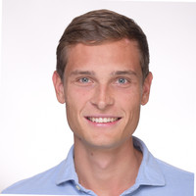
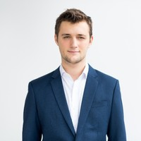



















Augustin, Consultant – Data Scientist
Rick, Consultant – Data Scientist
Romain, Consultant – Data Scientist
Prior to joining eleven, Augustin earned a Masters degree in Data Science at HEC Paris
Prior to joining eleven, Rick earned a Masters degree in Data Science at HEC Paris
Prior to joining eleven, Romain worked in various sectors, including consulting.
He joined eleven in order to apply his Data Science and Machine Learning skills to business problems
Tech &
digital skills
Sectorial expertise
Tech &
digital skills
Sectorial expertise
Tech &
digital skills
Sectorial expertise
Blockchain
Blockchain
Construction & Building Materials
Start-up Studio
Supply Chains
Digital marketing
Agile Method
Energy & Utilities
Agile Method
Machine
Learning
Software & Data
Automotive
Computer Vision
Healthcare & Life Sciences
Computer Vision
Cropper
Energy & Utilities
Private Equity
Education
Education
Education
McGill University
TUM - Munich
HEC Montreal
Ecole Polytechnique
Ecole Polytechnique
Ecole Polytechnique
HEC Paris
HEC Paris
HEC Paris

Slide 4







Alexis, Consultant – Data Scientist
Louis, Consultant – Data Scientist
Prior to joining eleven, Alexis made his reputation as a consultant.
Prior to joining eleven, Louis worked in retail at a large American company in Luxembourg.
He joined eleven in order to apply his Data Science and Machine Learning skills to business problems
Tech &
digital skills
Sectorial expertise
Tech &
digital skills
Sectorial expertise
Natural Language Processing
Financial Services
Start-up Studio
Supply Chains
Big Data analysis
Energy & Utilities
Machine
Learning
Software & Data
Infrastructure & Asset management
Cropper
Energy & Utilities
Machine
Learning
Education
Education
University of Geneva
McGill University
Ecole Polytechnique
Ecole Polytechnique
HEC Paris
HEC Paris

Slide 5
AGENDA
Presentation of 11
Problem Statement
11DeepCV Solution
Applications

Slide 6


A precise fuel and energy consumption monitoring will help control and optimize direct on site operations and general management of the different sites
On site advantages
General management advantages
Estimation of the consumption for the different months
Help making decisions concerning the purchase, resale, and turnover of the machines
Easy tracking of the running fuel costs for the machines used in different scenarios
Prevent ”fuel fraud”
Catch drivers that are more likely to make mistakes – but also their device if the drivers are not at fault (dyslexia, difficulties reading, tablet issues…)
Auxiliary to determine if a machine is in need of repairs (due to lack of efficiency or might break down soon)
Path optimization of the different machines on site
Understanding precisely the burnout rate of the machines under different loads and effort constraints (eg: in terms of fuel is a big machine much more costly than 2 that perform the same job?)

Slide 7



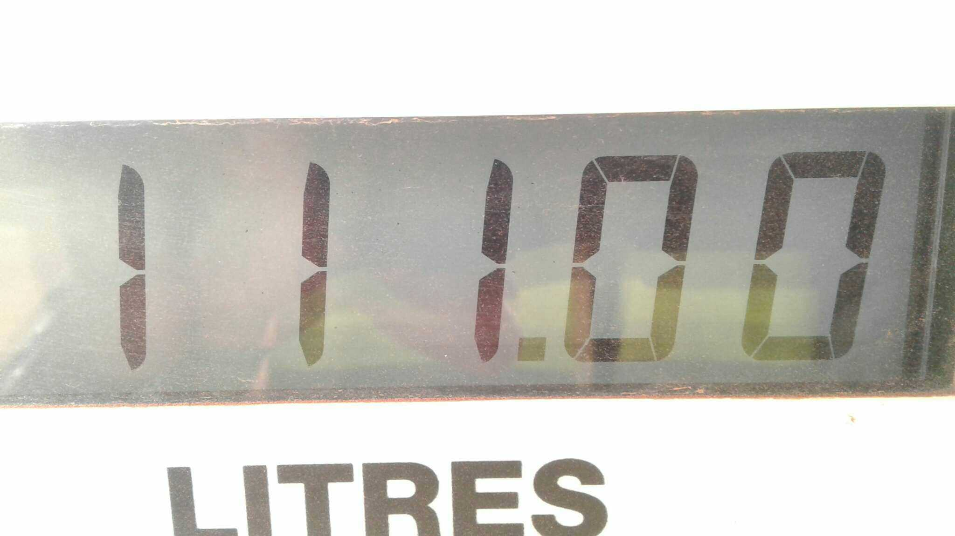

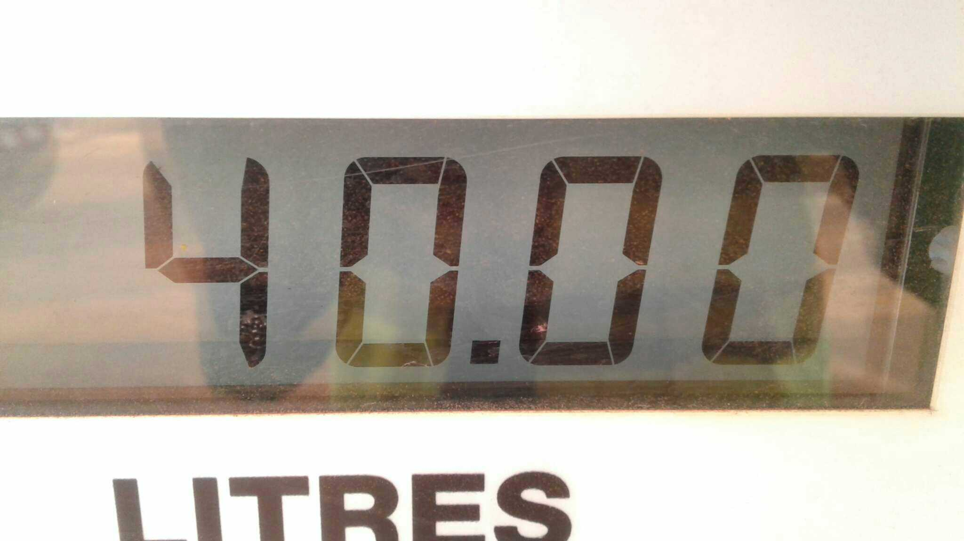

Operators mistakes while taking down fuel consumption leads to important irregularities in the management data
Driver input:
In the previous system
Mismatch between: calculated vs real volume in trucks
Digital Display
11.10
400
No checks were made on the inputs from the truck drivers.
As a result, inconsistency errors could arise

Slide 8
AGENDA
Presentation of 11
Problem Statement
11DeepCV Solution
Applications

Slide 9

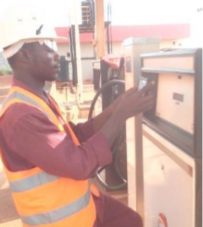
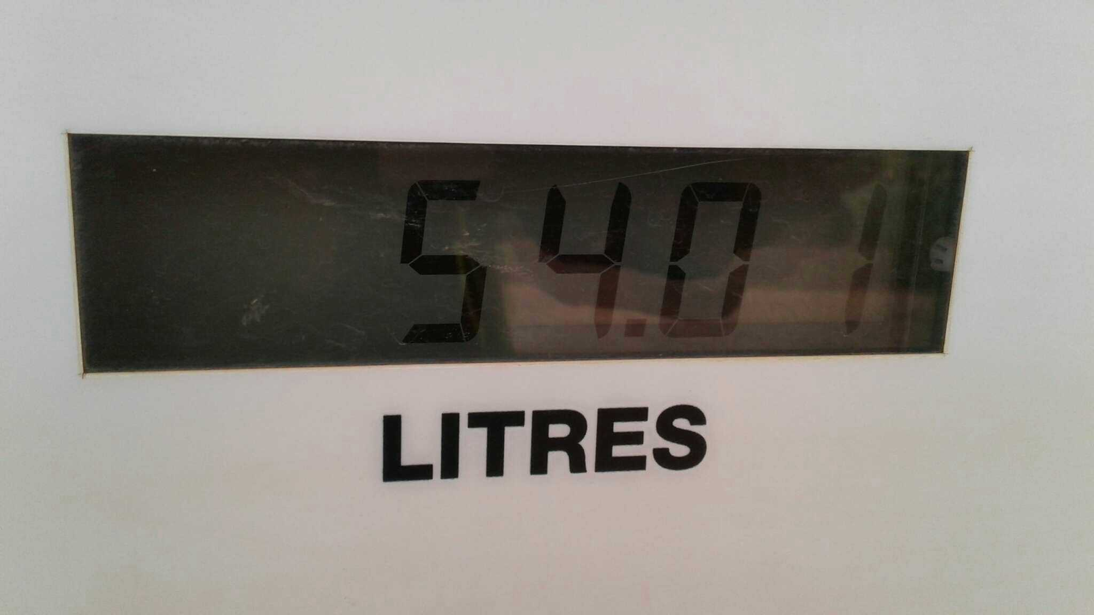

By adding an AI-driven verification step, we want to improve the accuracy of the fuel consumption reporting
Proposed workflow with our tool
Operator workflow
Operator write out the number
Operator takes a picture of the counter
If the number are different : Verify directly with the operator
Send data to operation and management
Additional verification
Photo taken by operator
11DeepCV solution
Detected number :
54.01

Slide 10
We used Deep Learning and Computer Vision AI model over a 3 step process to help recognize digits: 11DeepCV
Computer Vision
Computer Vision is concerned with understanding what is contained in the images
We used Open Source libraries, discarding any copyright and liability questions that might arise.
Deep Learning
Deep Learning is a form of artificial intelligence which mimics the human brain. We were able to teach it to recognize digits from images
Our three step process
LCD Cropping
Digit Extraction
Digit Identification

Slide 11
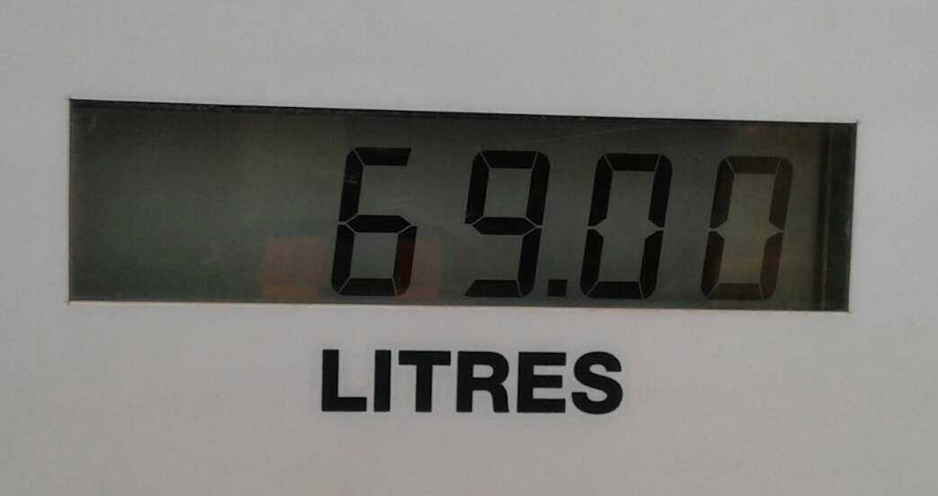

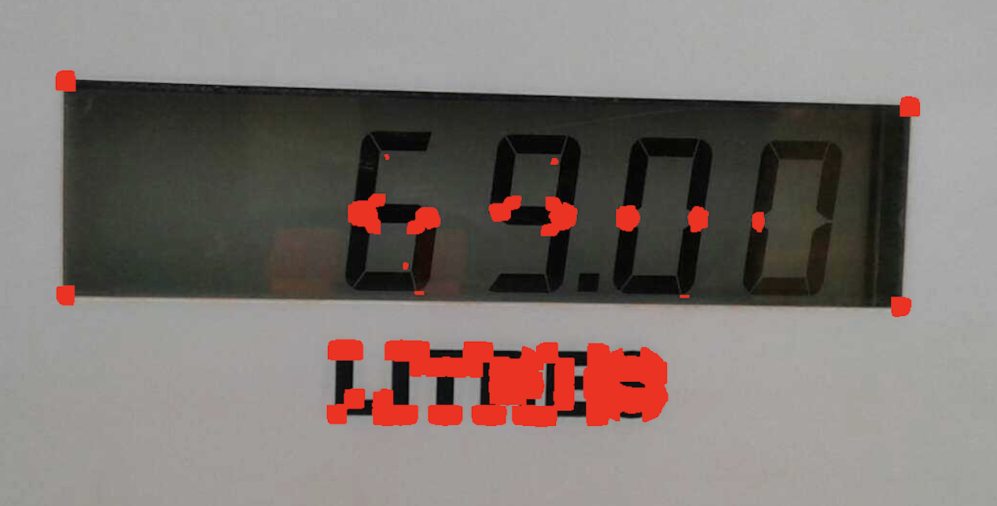
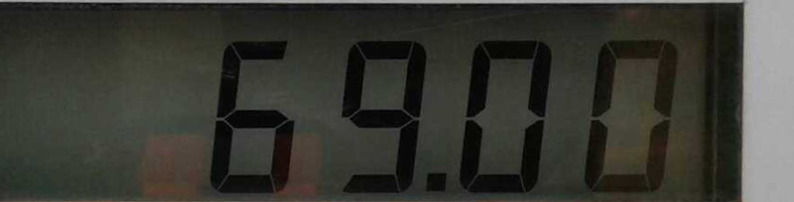
The 11DeepCV process in details
STEP 1:
Cropping the image to output the LCD SCREEN
Input: The original Picture
Accuracy of this process :
90-95%
Find the points ranking highest in a
measure of cornerhood
Extract the LCD screen by cropping within the outermost corner points
Consolidation of the process with 3 points reconstruction

Slide 12


The 11DeepCV process in details
STEP 2:
EXTRACTING THE DIGITS
FROM THE LCD SCREEN
INPUT: The LCD screen
Use computer vision techniques to isolate the digits and keep only those before the decimal
Accuracy of this process :
80-85%
OUTPUT: The digits and their position
, pos 1
, pos 2

Slide 13
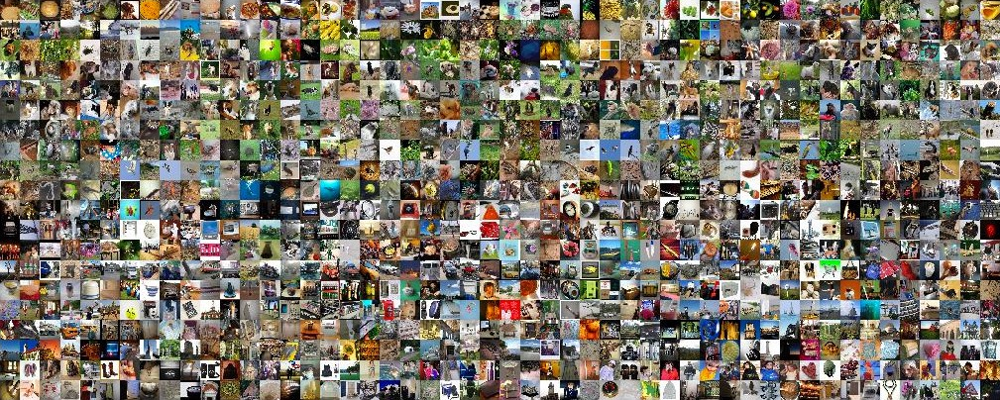

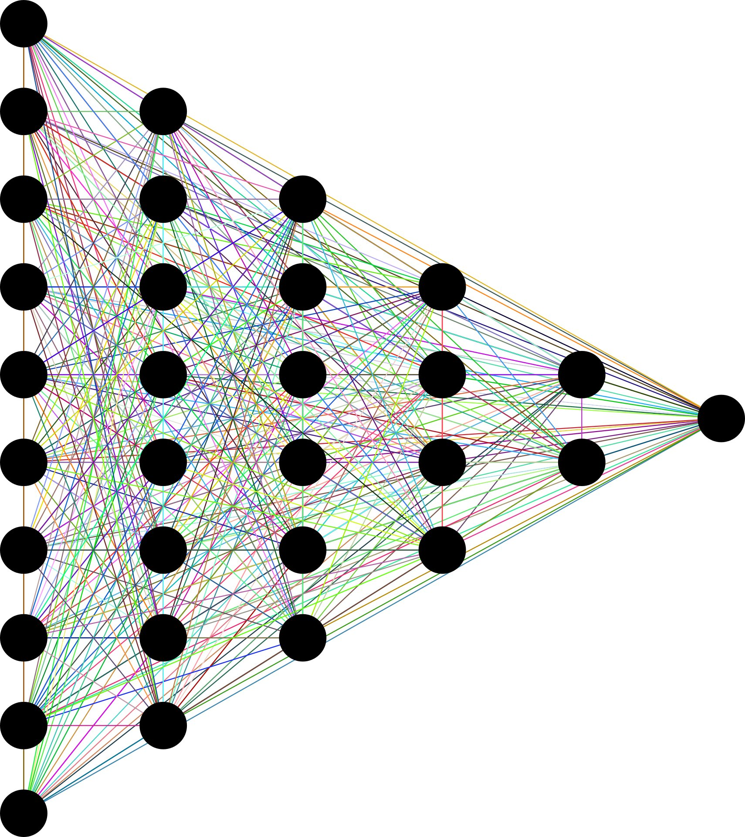

The 11DeepCV process in details
STEP 3:
IDENTIFYING THE DIGITS
Training set
Train accuracy :
92%
Test accuracy :
56%
Millions of pictures for pretraining
2000 training digits
, pos 1
, pos 1
69
, pos 2
, pos 2
Neural Network (Transfer Learning)

Slide 14
AGENDA
Presentation of 11
Problem Statement
11DeepCV Solution
Applications

Slide 15
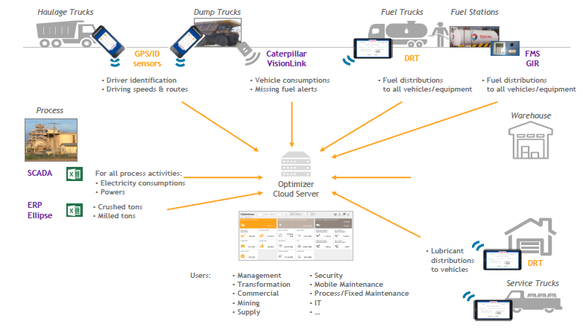
Our consulting team developed a dashboard used to monitor fuel and lubricant consumption in mining sites by building a pipeline to integrate various data sources in a dashboard
Making it easy

Slide 16
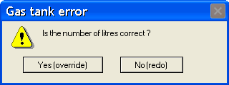
Our proposal : We implement 11DeepCV with a pop-up system for the drivers
Making it useful
When there is a mismatch between the driver’s manual input and 11DeepCV’s output, we can remind the driver of the discrepancy and ask him to review his input.
The driver can always override 11DeepCV’s pop-up.
Driver: Patrick Pouyané
DriverID: 123456
Driver: Patrick Pouyané
DriverID: 123456
Gas consumption (in Litres):
Gas consumption (in Litres):
11.10
11.10
Picture of gas tank:
Picture of gas tank:
Truck Use
Truck Use
Transport mats A to B
Transport mats A to B
Truck comments (issues…)
Truck comments (issues…)
NA
NA

Slide 17
Our next goal is to improve our solution to best fit your business needs
Discussion
Technical improvements are possible over these technical aspects :
Cropping the LCD screen and separating the digits can be improved, some smudges still hinder performance
The neural network (digit identification) performance will increase as more training data is inputted automatically by the drivers
Other solutions to leverage the 11DeepCV are possible :
Connecting user interface to on-site managers’ devices
Sending alerts and live stream of the interface when an incoherence is found

